Slide 1


Rockbuster Stealth Data Project Analysis
By Olusola Olaniyi
December 2023
Tableau link: https://public.tableau.com/app/profile/olusola.alabi

Slide 2


Rockbuster Stealth LLC
Rockbuster Stealth LLC is a movie rental company transitioning to an online video rental service to stay competitive
The biggest competitors: Netflix and Amazon Prime
The company’s goal is to plan to use its existing movie licenses to launch an online video rental service to stay competitive with the other streaming providers

Slide 3


Data Overview
Total Number of Movies: 1000
Total Number of Movie Genre: 20
Total Number of Countries: 109
Total Number of Customers: 599

Slide 4

Key Questions and Objectives
Questions
Questions
What are the minimum and maximum rental durations?
What is the average rental duration?
What is the average rental payment?
What is the average replacement cost?
Which countries are Rockbuster customers based in?
What are the top 10 Countries and Cities that hold the most customers?
Who are our top 10 most paying loyal customers?

Slide 5

Movie Rental and Duration
Minimum rental duration
Maximum rental duration
Average rental
duration
3 Days
7 Days
5 Days

Slide 6

Movie Rental Payment
Minimum rental rate: $0.99
Maximum rental rate: $4.99
Average rental rate: $2.98

Slide 7

Replacement Cost
Minimum replacement cost: $9.99
Maximum replacement cost: $29.99
Average replacement cost: $19.98

Slide 8

Customers Around the world 599 customers in 109 countries around the world
Global Customers

Slide 9
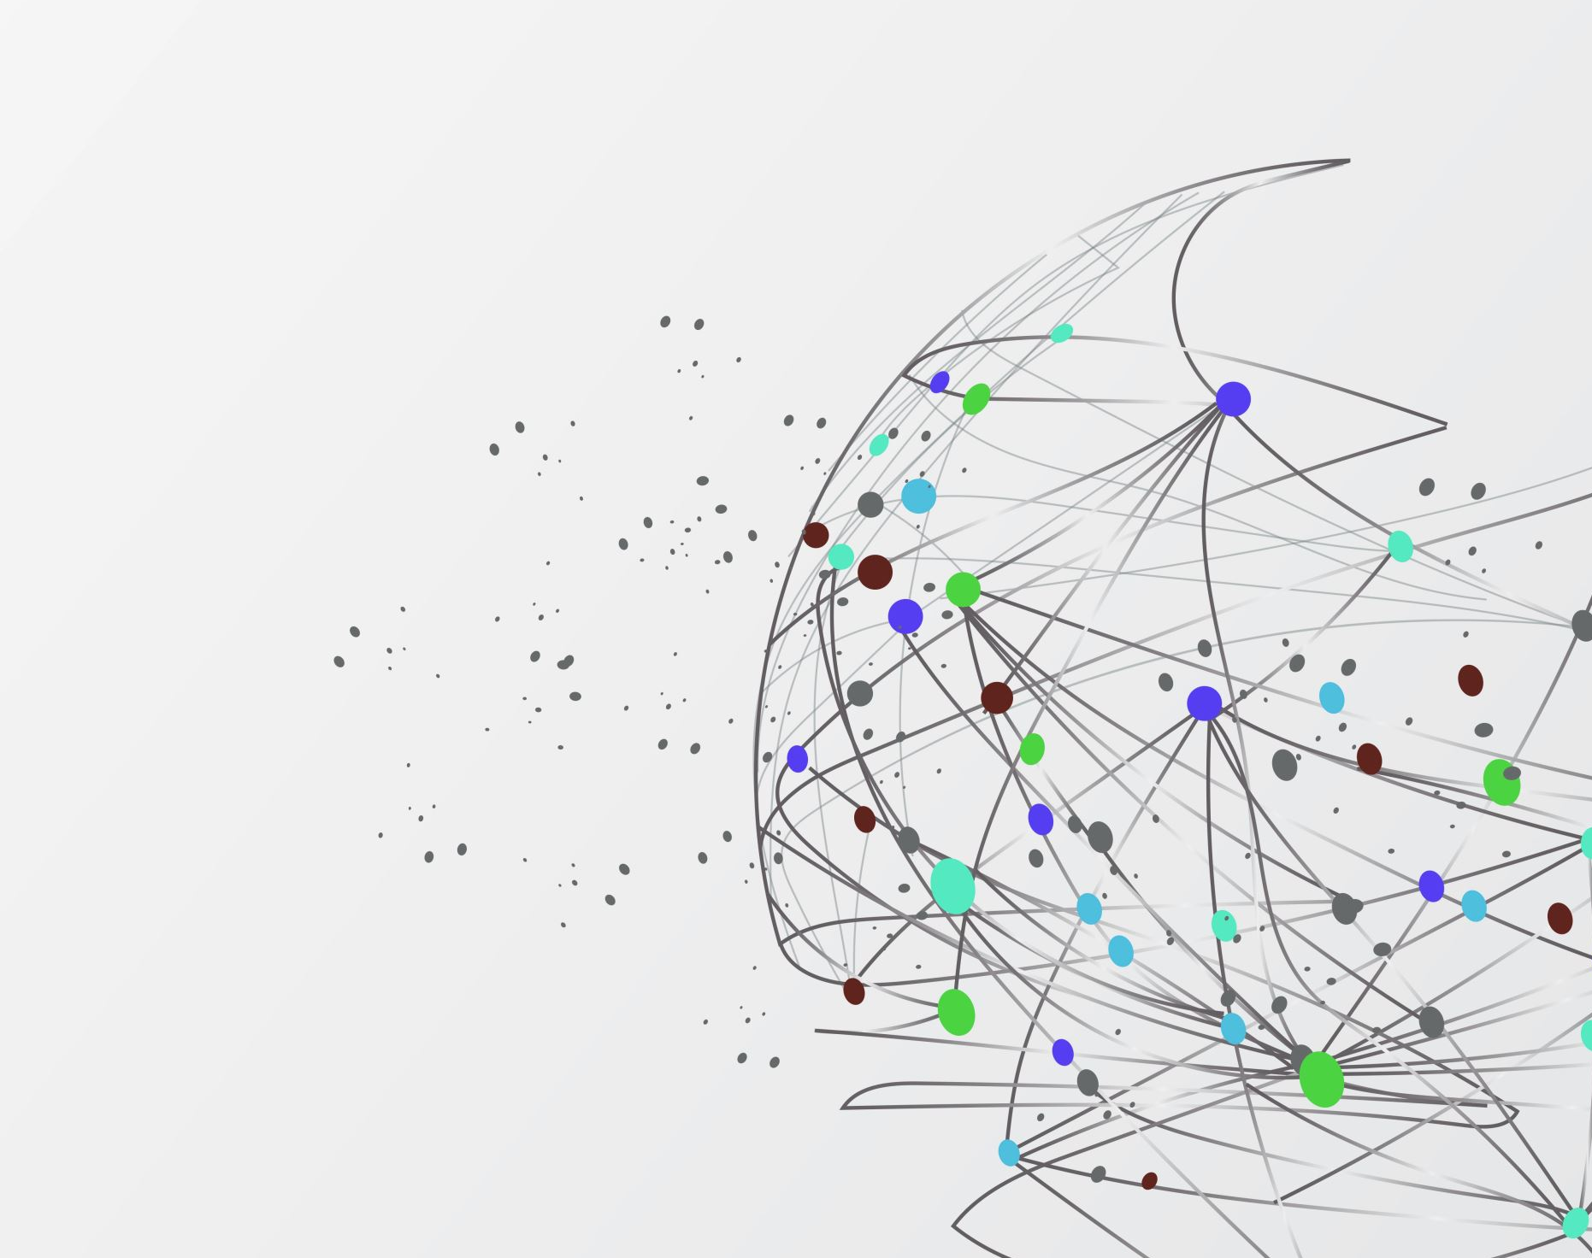
WHERE ARE THE CUSTOMERS BASED ?
Rockbuster customers location around the world

Slide 10

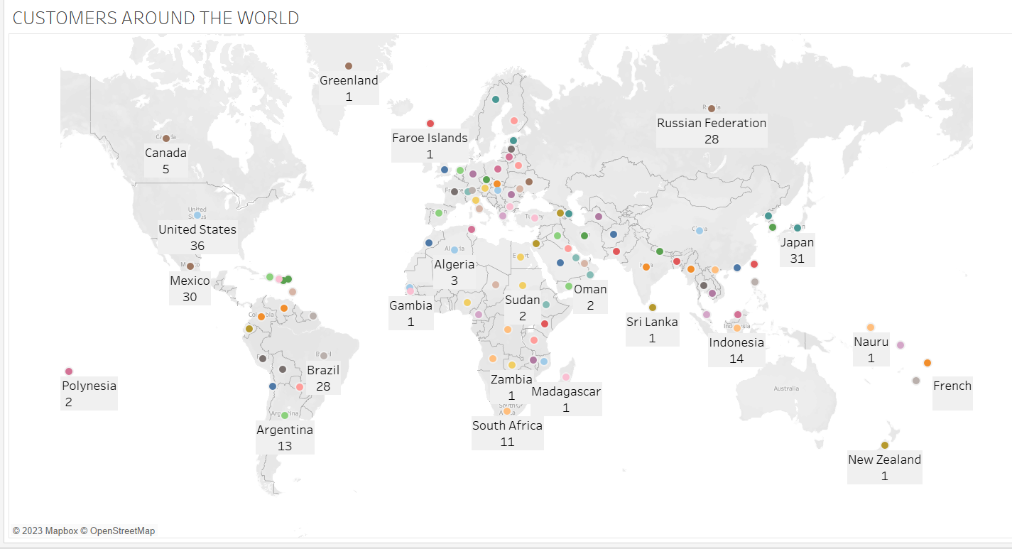
Rockbuster Customers Location Around the World

Slide 11
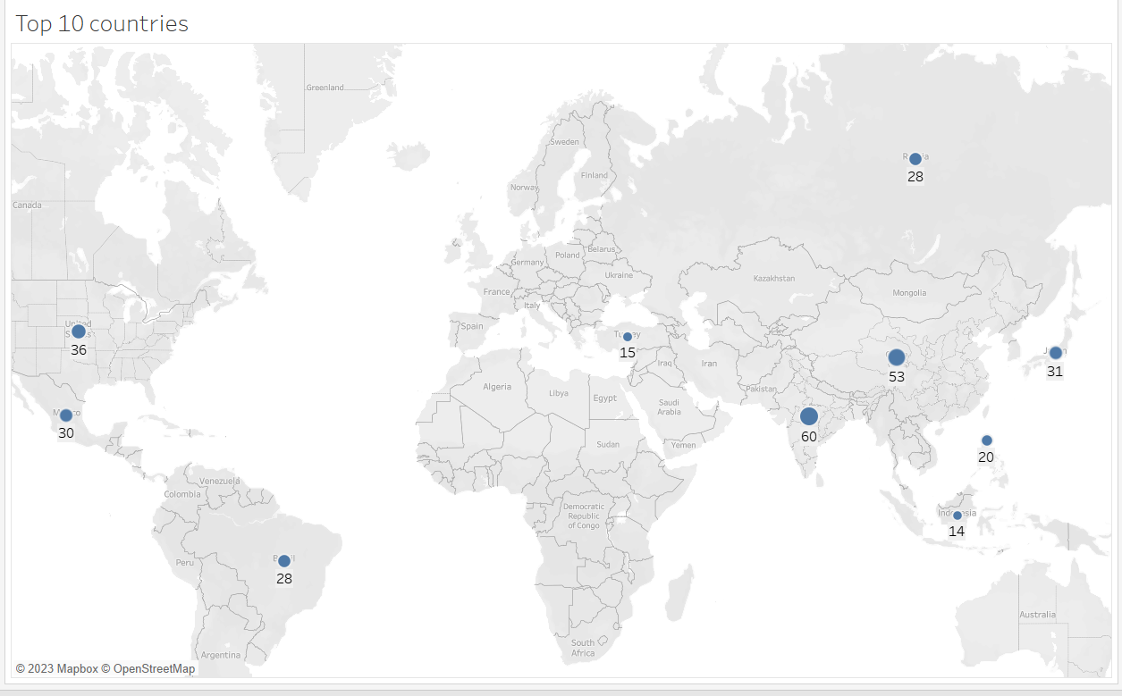
Top 10 Countries With Highest Number of Customers

Slide 12
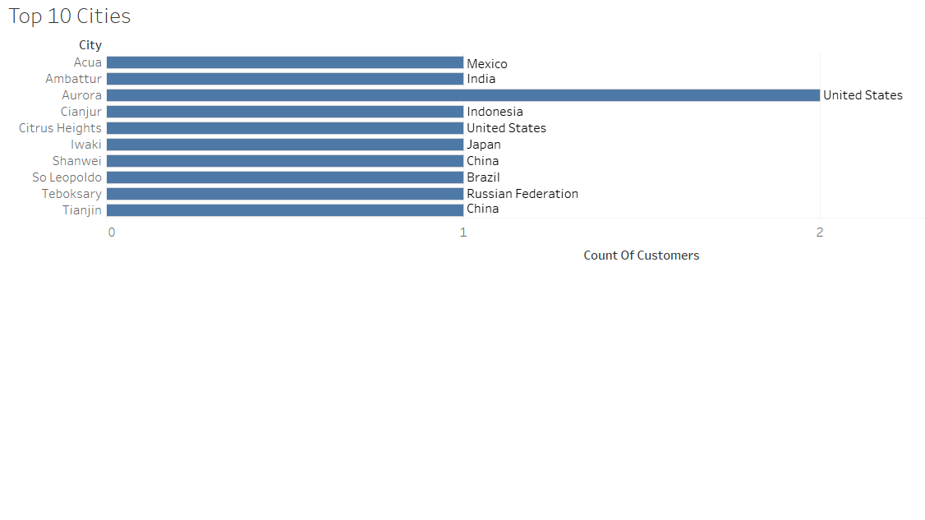
Top 10 Cities Around the World

Slide 13
Top 10 Most Paying Customers
First Name | Last Name | City | Country | Total Amount Paid
Kyle | Spurlock | Shanwei | China | 109.71
Marlene | Welch | Iwaki | Japan | 106.77
Glen | Talbert | Acua | Mexico | 100.77
Clinton | Buford | Aurora | United States | 98.76
Betty | White | Citrus Heights | United States | 96.77
Francisco | Skidmore | So Leopoldo | Brazil | 93.79
Dora | Medina | Tianjin | China | 88.81
Norman | Currier | Cianjur | Indonesia | 73.76
Juan | Fraley | Teboksary | Russian Federation | 63.79
Scott | Shelley | Aurora | United States | 60.82

Slide 14
RECOMMENDATIONS
Introduce exclusive promotions, discounts, and loyalty programs to reward customer loyalty
Implement a robust recommendation system that provides personalized movie suggestions based on customer preferences and viewing history
Offer exclusive content and early releases as incentives for customers to choose Rockbuster's online rental service over competitors
Establish a responsive and efficient customer support system to address queries, concerns, and technical issues promptly

Slide 15
THANK YOU
Olusola Olaniyi
Olusola_olaniyi2762@yahoo.com
www.p-l-a-n-e-t-b-l-o-g.com

